Slide 1



Slide 2

Tender Evaluation
Training

Slide 3

Training Objectives
Understand:
Why training is needed?
The roles and responsibilities of Panel members
The tender evaluation stages
The difference between selection and award criteria
How to use the Tender Assessment Model [TAM] and the importance of consistent commentary

Slide 4
Why tender?
Gets you what you actually need
Maintaining a competitive price
An awareness of alternatives and options available in the market place
Drive the agenda on your terms not the supplier
Commitment from Quality Suppliers

Slide 5

What is tender evaluation?
Objective assessment of potential Suppliers against specific criteria.
Selecting the tenderer whose proposal is the Most Economically Advantageous Tender (MEAT).
Demonstrates that we have conducted the process in a fair and transparent manner
Provides a robust audit trail that can stand up to scrutiny

Slide 6
The Evaluation Panel
Panel members must be competent
The role of Procurement
Each Panel member must read and evaluate each tender with integrity and consistency
To produce an individual set of scores and corresponding justification on the Tender Assessment Model (TAM)
Confidentiality

Slide 7

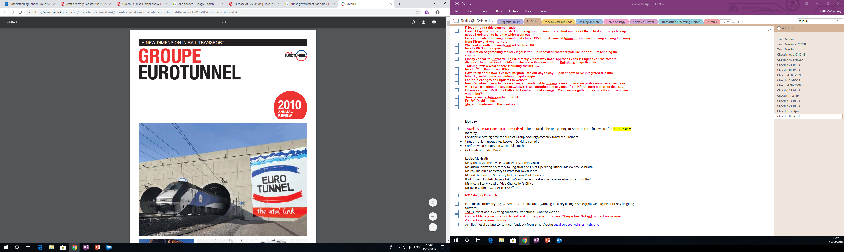
Why is training needed?

Slide 8
Procurement Plan Identifying the Panel
Prepare the specification and award criteria
Conflict of interest
Input into clarifications
Receive tender responses/ score
Consensus scoring meeting
Standstill
Contract Award
Contract Implementation/Delivery Contract Management
Key stages in the Evaluation Process
Award Stage
Pre- tender stage
Tender Stage

Slide 9
Selection Criteria
Award Criteria
Pre- tender stage
Looks Back
Capability and Capacity
Looks forward
How will the supplier deliver?

Slide 10
Exercise 1

Slide 11
Pre- tender stage
Getting the questions right and weighting accordingly
Each tender exercise is unique therefore questions must be tailored
Is the question and weighting appropriate?
Consider Price/Quality Split
Consider whats important to you

Slide 12

Buying a car
Specification
Purchase/Running Costs
Features?
Did you shop around?

Slide 13
Exercise 2

Slide 14
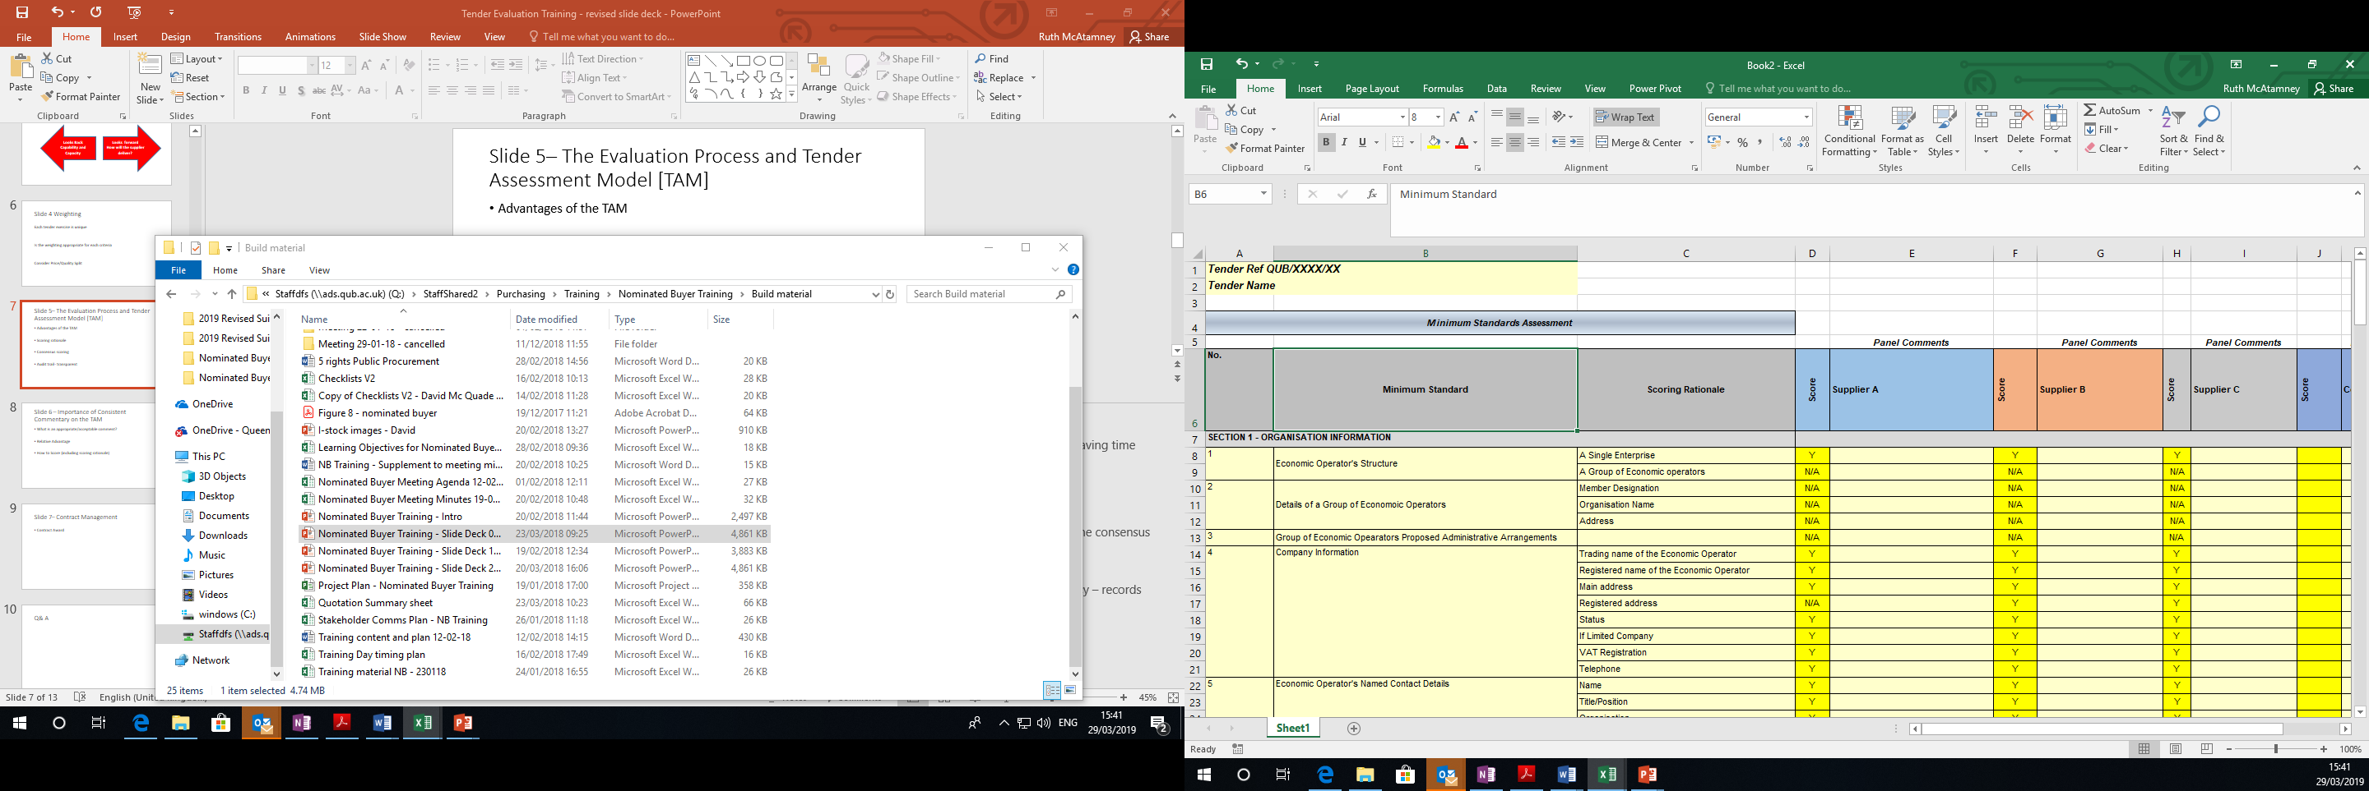
The Evaluation Process and TAM
Tender stage
Advantages of the TAM
Scoring rationale
Consensus scoring
Audit trail - transparent

Slide 15
Importance of Consistent Commentary
Tender stage
Appropriate/acceptable comment
How to Score (including scoring rationale

Slide 16
Exercise 3

Slide 17
Exercise 4

Slide 18
Exercise 5

Slide 19
Relative Advantage
Tender stage
We need to give the reason for our decision, including the characteristics and relative advantages of the successful tender

Slide 20
Award stage
Contract Management
Contract Award

Slide 21
Questions?

