Slide 1
How to access Questionmark

Slide 2
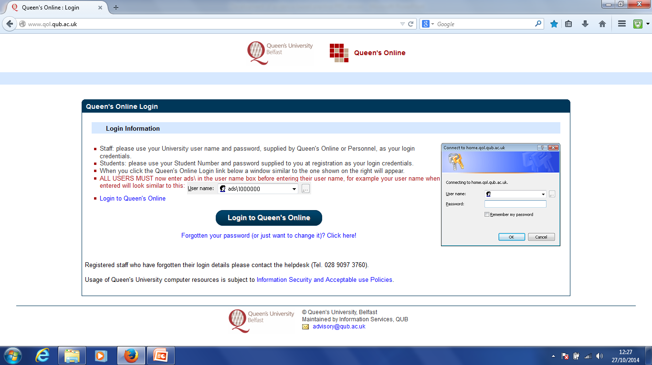
1. Login to Queen’s Online with your user name and password

Slide 3
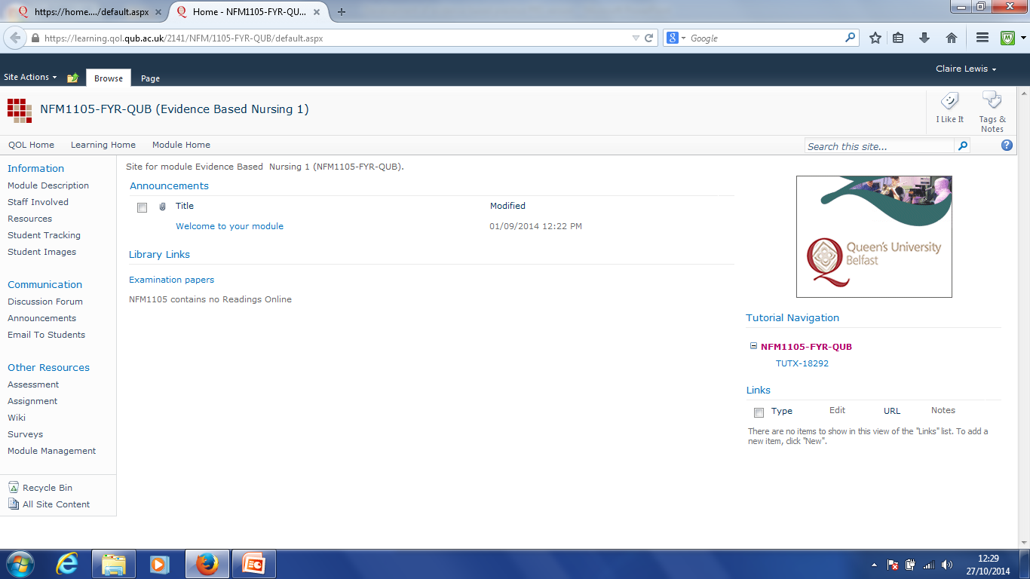
2. Open the EBN 1 (NFM1105) module folder. Click on ‘assessment’

Slide 4
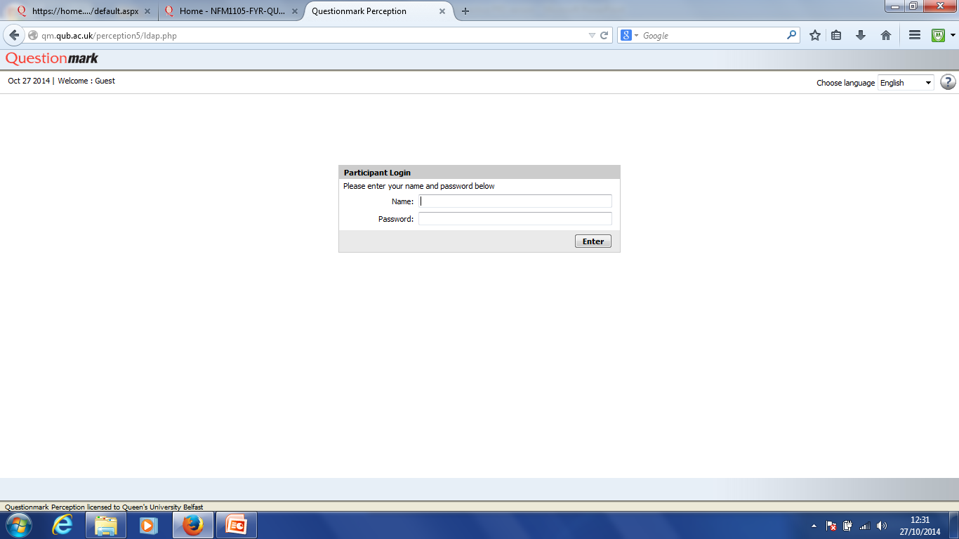
3. Enter your student number and password (no ads\ required at this stage)

